Slide 1


CYSCP Learning Masterclass
Harmful Sexual Behaviour (HSB)

Slide 2
Harmful Sexual Behaviour - HSB
“Sexual behaviours expressed by children and young people under the age of 18 years old that are developmentally inappropriate, may be harmful towards self or others, or be abusive towards another child, young person or adult.”

Slide 3
Technology Assisted Harmful Sexual Behaviour – TA-HSB
“TA-HSB refers to one or more children engaging in sexual discussions or acts – using the internet and/or any image-creating/sharing or communication device- - which is considered inappropriate and/or harmful given their age or stage of development. This behaviour falls on a continuum of severity from the use of pornography to online child sexual abuse”
(Hollis and Belton 2017)

Slide 4
How serious is it?
It’s important to first identify how serious any behaviour is and professionals need to distinguish normal from abnormal sexual behaviours. CYC practitioners can use Hackett’s Sexual Continuum available on the NSPCC learning website which provides a means of identifying and determining where the behaviour sits on a continuum of behaviours from normal to inappropriate, problematic, abusive and/or violent
https://learning.nspcc.org.uk/child-abuse-and-neglect/harmful-sexual-behaviour

Slide 5


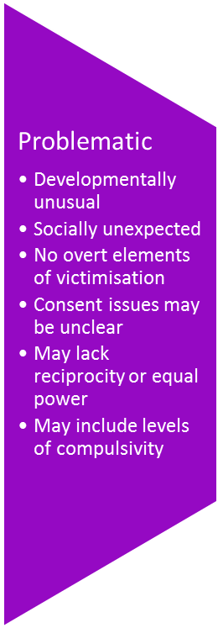
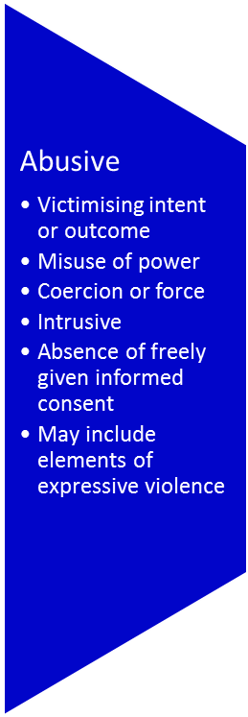

Continuum of behaviours (Hackett, 2010)

Slide 6
Importance of Identification
Correctly identifying how serious the behaviour is provides clarity on how to respond and aids the determination of defensible decisions about safeguarding children and young people
The wide range of harmful sexual behaviours shown by children and young people means their needs should be met in a variety of placement contexts and responses. Young people are still developing sexual feelings and understanding and some may have additional needs (e.g. learning difficulties or ASD). Not all sexual contact between children and young people can be described as sexually harmful and it is natural for children to explore their bodies as part of natural sexual development.
Therefore any response to children and young people’s HSB should reflect the level of concern and need they present, and should be at the least intrusive level required to effectively address the behaviours presented.
The Youth Justice Service can offer advice and guidance if you have concerns around potential Harmful Sexual behaviour. The Youth Justice Service can be contacted during office hours on our duty number – 01904 554565. We do not provide an out of hours service.

Slide 7
Response
It’s important that incidents of HSB are not ignored and that they are responded to in a timely and consistent manner. Early intervention in cases of harmful sexual behaviour can enable young people to adopt a healthy development pathways and proceed to make healthy relationships.
Taking decisive steps to respond to HSB helps to;
• Identify potential risk of repeated harmful sexual behaviour
• Identify risks to either the child/young person carrying out the behaviours or their actual/potential victim(s)
• Identify the child/young person’s needs including immediate sexual health needs
• Assess the child/young person’s motivation and capacity to engage in services and plans
• Identify the capacity of the parents/carers to manage and support the child/young person

Slide 8
Response
Normal/Inappropriate behaviour – Usually these behaviours can be responded to through direct interaction with the child or young person and the giving of information, advice and explanation of boundaries with guidance including issues of privacy and consent. Early Help Services are available to provide advice and guidance through the Multi Agency Safeguarding Hub (MASH) on 01904 551900.
Problematic Behaviour - There may be instances in which if there is an absence of direct/indirect victims, problematic behaviours also result in a single agency response through targeted intervention, advice or guidance. If the agency or individual who become aware of the issue is unsure as to how to respond or the correct category of the behaviour the MASH should be contacted. The Mash will be able to offer advice and can then signpost to other professionals and/or agencies including the Youth Justice Service and those in the voluntary sector to provide information and resources to use to work with the young person displaying the HSB and those impacted by the behaviour. Further advice can be found at https://www.saferchildrenyork.org.uk
Abusive/Violent Behaviour - If behaviour is found to fall within the Abusive or Violent categories and there is concern that a child, young person or an adult might have been harmed by the behaviour of the child or young person then the behaviour should be reported to the Police if it has not already been done so. Allegations of peer abuse should be taken as seriously as allegations of abuse perpetrated by an adult. In cases of peer on peer abuse both young people will need to be considered and allocated separate Social Workers. Behaviour falling into these last two categories must also result in a referral to the MASH for each child/young person.

Slide 9
What Happens next?
A lot depends on whether there is going to be a police investigation or prosecution. If there is, then the young person will be supported through the process and the YJS will ensure that any identified HSB will be assessed and appropriate intervention delivered at the earliest opportunity. The YJS can provide voluntary bail support in the short term if they are on bail or have been released under investigation. This could be limited to a one off visit or support session or depending on need for the duration of the investigation.
However where it is concluded it is either not in the public interest to do so or there is insufficient evidence to charge then there remains the need to address the identified HSB though targeted HSB intervention.

Slide 10
The YJS HSB Service
In April 2019 the Youth Justice Service launched a Harmful Sexual Behaviour Service seeking to provide intervention work with young people around identified HSB concerns that had not resulted in ongoing police investigation or prosecution.
The service provides the opportunity to voluntarily engage with children and young people displaying these behaviours with the aim of preventing offending and reducing re-offending.
Government findings indicate that those young people offered early intervention benefit from the child centred approach of Youth Justice practitioners and their chances of rehabilitation improve. Such intervention can enable young people to adopt a healthy development pathway and proceed to make healthy future relationships.
The Youth Justice Service currently only take referrals for the HSB service directly from Children’s Social Care.

Slide 11
Interventions
Following assessment an intervention plan is prepared and tailored to the young person’s risks and needs.
Plans can include interventions focussed on;
Healthy relationships
Keeping Safe
The Law and Issues of consent
Social Media, Pornography and the Internet
Family safety plans
Emotional regulation
AIM3 Assessments and Intervention

Slide 12
AIM3 – What is it?
The AIM3 is a tool developed by Marcella Leonard and Simon Hackett and used for assessing young people who have committed or where there are serious concerns that they have committed Harmful Sexual Behaviour.
Aim stands for Assessment, Intervention and Moving on and this is the 3rd incarnation of the tool hence it’s called AIM3.
Is not a statistic based risk assessment but rather a tool for assessing somebody’s HSB within the context of multiple domains of a Young Person’s life.

Slide 13
AIM3 – Why do we use it?
The AIM3 is designed to assist practitioners in reviewing alongside the young person and their parent/carer what are the most appropriate interventions to reduce the identified areas of concern.
It ensures individualised safety plans and targeted interventions as the young person progresses in their pathway to addressing the HSB.
AIM3 focusses the practitioner to consider the HSB within the wider context of the young person’s life. It looks at the young person across 5 Domains - Sexual, Non-Sexual, Developmental, Family/Environmental and Self-Regulation.
The assessment of these Domains creates a graph profile of the young person which gives a helpful visual representation and identifies what areas require immediate risk management (red), medium/long term (amber) intervention as well as what possible strengths (green) exist for the young person which can be used to help guide intervention work.

Slide 14
AIM3 – Who do we use it for?
It’s designed to be used for young people aged 12-18.
There is a version that has been developed for under 12’s although York YJS do not have anyone trained in this assessment at the current time.
The authors note that it can be used with females although state that it should be used with caution because the research and evidence base for the development of the tool is based on samples of predominantly young men.
Similarly it can be used for those with learning and developmental disabilities with a caveat that sometimes additional consideration needs to be given and for example like adapting interview technique or arranging for a parent to be present.
For those with online or TA-HSB then there is a separate Assessment so the AIM3 doesn’t fit for young people with exclusively online offending.

Slide 15
AIM3 – When do we use it?
There are three routes first and as long as we have consent, agreement from the young person/family we can be approached to write one by the police and CPS to aid in their decision making around a potential prosecution – we don’t give an opinion on whether there should be a prosecution we just write the assessment.
Secondly they can be requested by the Court or written as part of a sentencing hearing
Thirdly they can be written as part of our voluntary engagement with Y/P referred to the HSB Service. The authors are clear that not all HSB committed by a young person will require a complete AIM3 Assessment.
It’s normally going to be the more serious and troubling behaviour that is going to trigger one being written and you can use Hackett’s Continuum identification tool to help determine if the behaviour is more concerning.

