Slide 1



Staying Safe on Social Media

Slide 2






Lesson Objectives
Explore the positives and negatives of social media
Explain some of the ways that young people, adults and technology companies can promote safer social media use
Provide ideas about how you and other young people can stay safe on social media
Notes:
Provide an overview of the three different activities that the workshop will entail. This workshop is designed to create resources to be used within the school to promote safe social media use. To be able to do this we need you, as the main users of social media, to produce ideas about what are the positives and negatives online, and what you can do to protect yourselves, but also what others can do to help promote safe social media, too.

Slide 3
Positives and Negatives of Social Media
Things you see on social media
Things you do on social media
Things you see advertised
How you interact with others
Notes:
Ensure students are sitting in groups and that each group has a sheet of flipchart paper and some markers. Using the flipchart paper on your table, work as a group to brain storm the positives and negatives aspects of social media in relation to following: [1] Things you see on social media (what your friends post or people you follow post), [2] Things you do on social media (Your posts), [3] How you interact with others (liking/commenting on posts – negative or positive/ conversations you have, private or public) and [4] things you see advertised (for example fake websites, cyberscams, things you’ve bought from adverts on SM). 10 minutes

Slide 4


Positives on Social Media:
Talk to your friends and have a laugh with friends
Expressing/playing with your identity through selfies
Keep up-to-date with celebrities/news stories/long-distance family/friends
Share your memories through posts/pictures
Spread positivity
Show support to friends
Notes:
Ask students to feedback their positives to social media first. Then, go through the positives on the slides to make sure all are covered, including: [1] Talk to your friends and have a laugh with friends – the ability to keep in contact with friends when not in school seems to be the biggest appeal to social media, [2] expressing/playing with your identity through posting images [3] keeping up to date with celebrities, news stories, long-distance family and friends [4] social media can often be used to spread positivity and raise awareness, and finally [5] able to show support to your friends. So no one is saying social media is a bad thing, it actually has a lot of positives to it and most people really enjoy it.

Slide 5
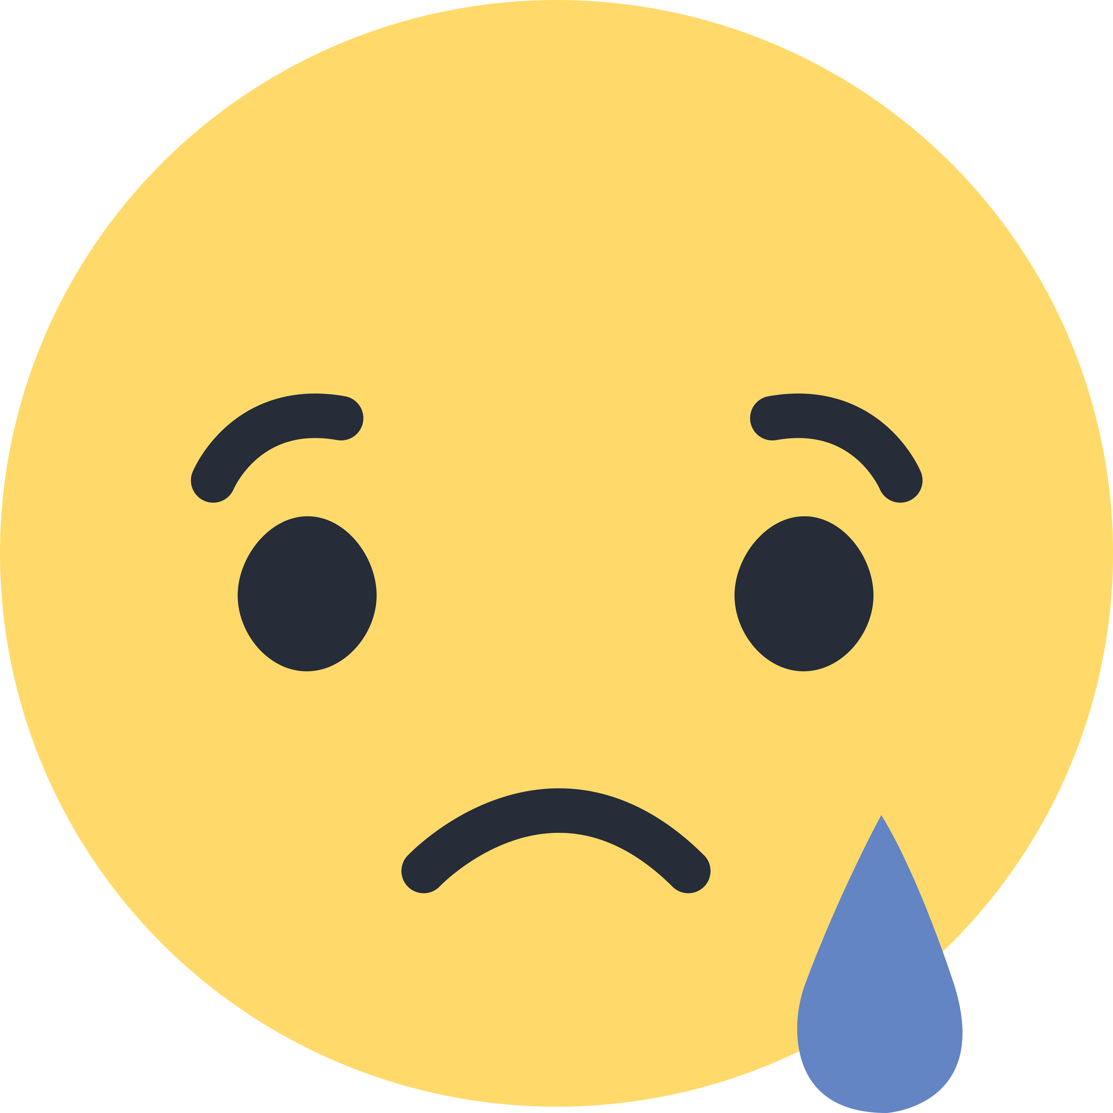
Negatives on Social Media:
Receive negative comments about appearance
Be bullied through anonymous websites
Have your personal details stolen
Be a victim of an online scam
Start to feel negative about appearance
Feelings of FOMO
Notes:
However, there are some negatives to social media. Get feedback from students first, before going through the examples on the slide to make sure all covered. So these are some of the negatives on social media that young people have discussed in previous social media safety workshops: [1] receiving negative comments about appearance and personality, [2] being bullied or harassed through anonymous websites, [3] having your personal details stolen via social media, [4] being a victim of an online scam that is advertised through social media, [5] start to feel negative about appearance due to seeing unrealistic images on social media, and finally [6] the fear of missing out - when you see your friends positing things that they are doing, and you feel left out or that you are missing out on something.

Slide 6
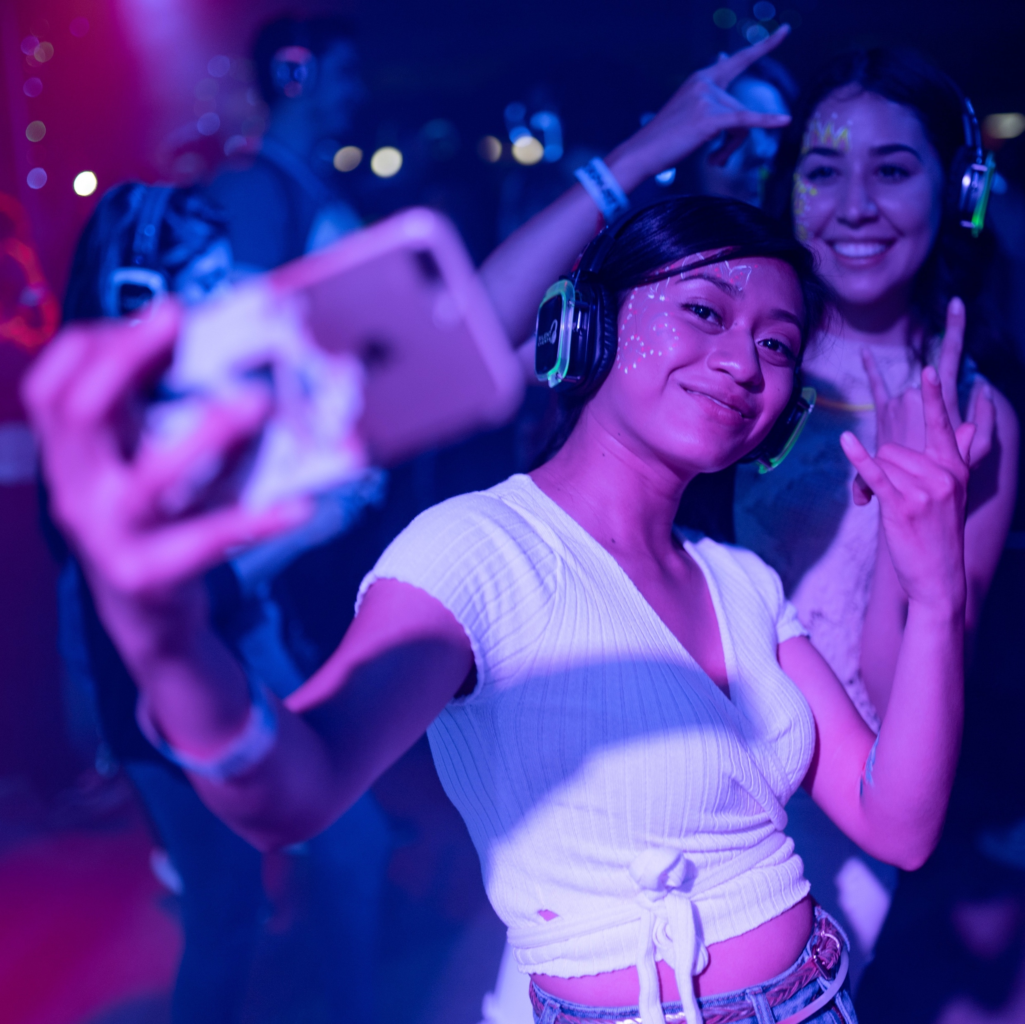
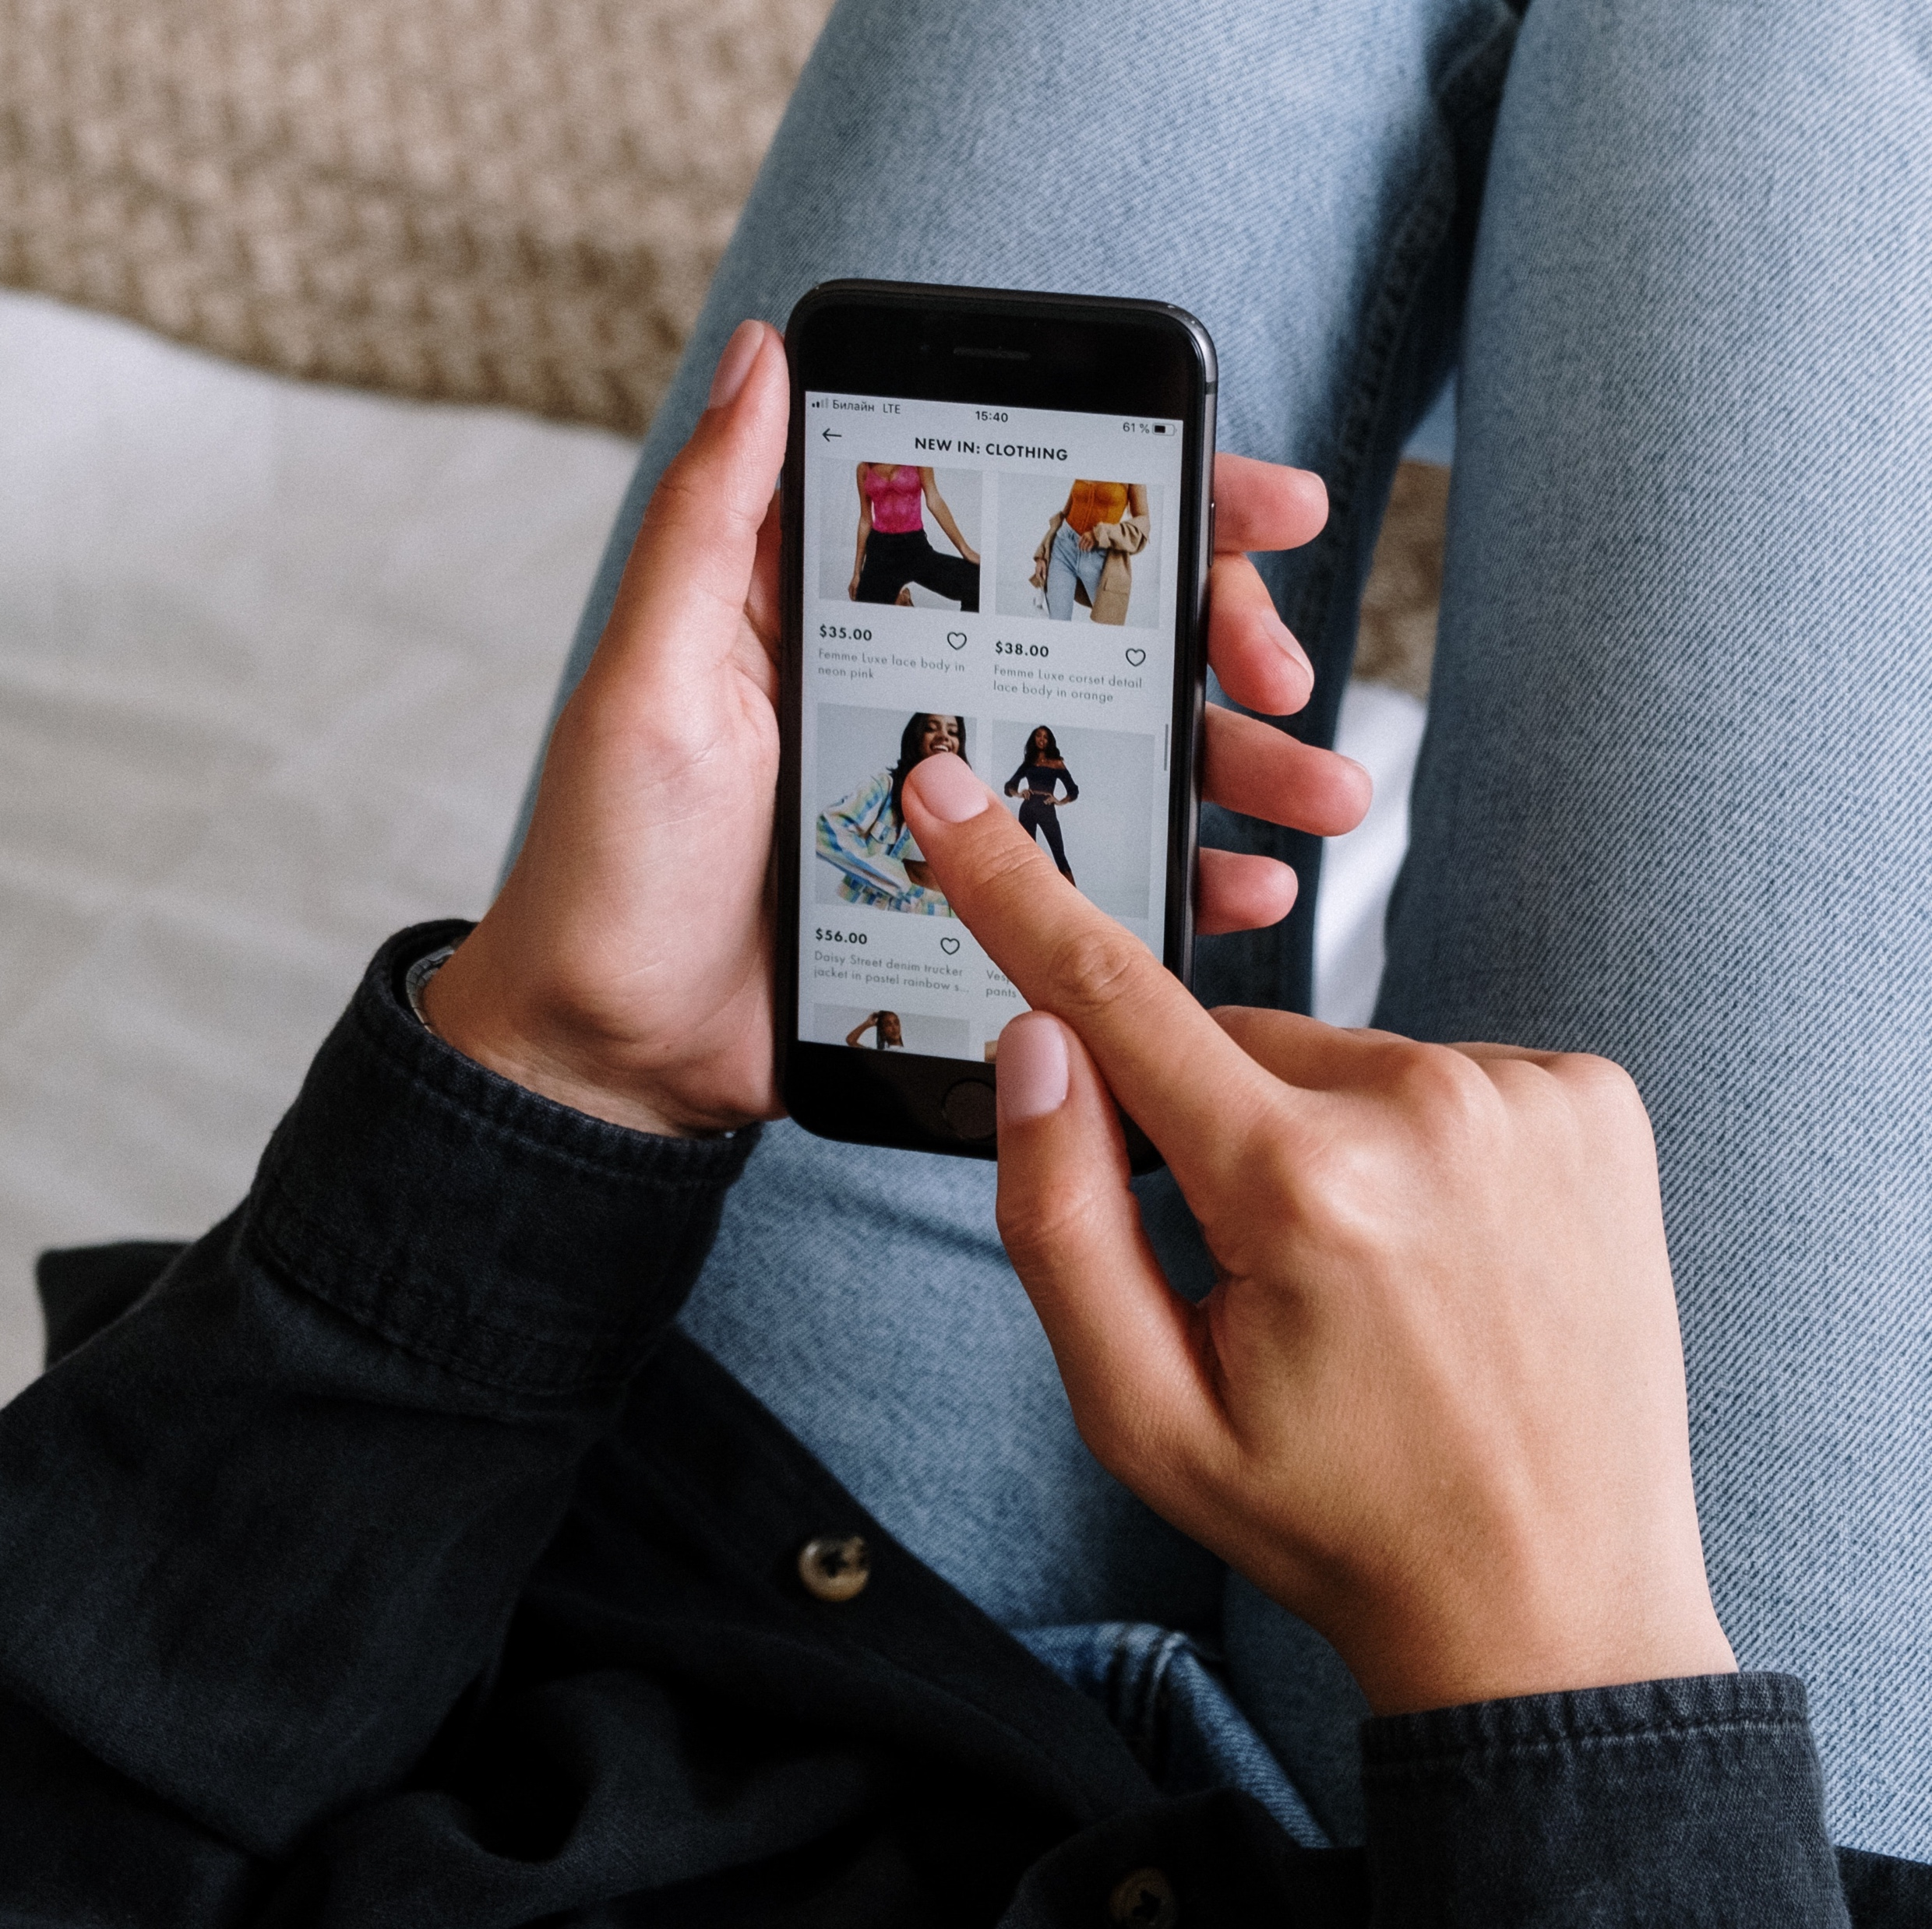
A little bit of both?
Positive and Negative on Social Media:
Selfies with friends at a party – might make other people feel bad, fear of missing out (FOMO)
Tagging your location on posts in real time – creating memories online to look back on, risk of someone you might not want to know your location can find you – get burgled if you’re on holiday
Private/Personal conversations with friends – good to chat with friends – but a comment could get screenshotted and taken out of context causing drama
See a link to some really nice clothes but it is actually false and scams money
Notes:
BUT, some of the things may be a little bit of both – both a positive and negative. Examples include [1] selfies with friends at a party might making people feel bad – FOMO, [2] location tagging helps you find friends/link memories but burgled, [3] have a private/personal chat with friends but could be screenshotted and shown to others, [4] post a beach pic and get comments, you see a link to a clothing site and it is fraudulent/scams money. End by asking students for any other suggestions of social media behaviours that can be both positive and negative.

Slide 7
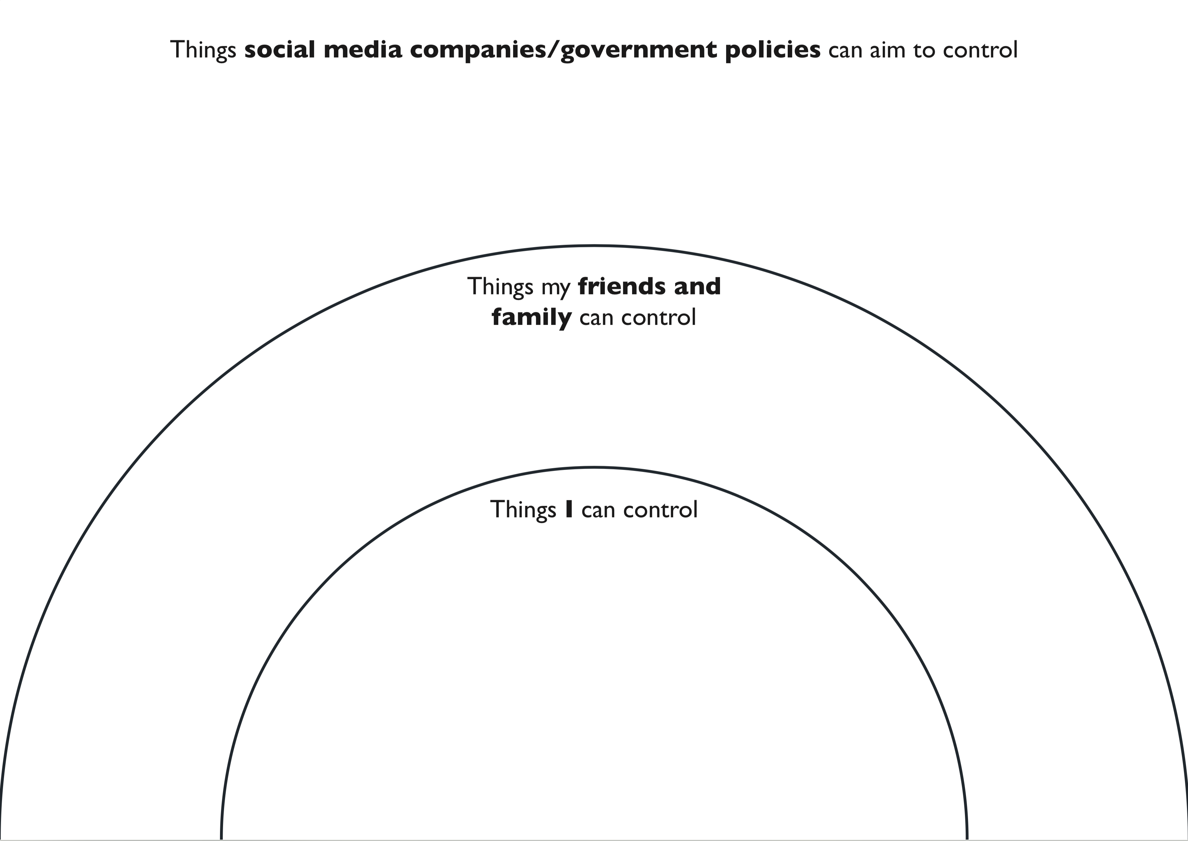
How can we protect ourselves and others?
What can I do
What can my family and friends do
What can social media companies and government policies do
Notes:
Distribute Activity 2 worksheet and personas. So with this in mind, how can we – and others - protect ourselves when using social media? First of all, it is worth remembering that staying safe on social media should not be the responsibility of one individual user – in addition to the stuff that we can control, there are things that friends and family members can do, and also things that social media companies/government policies can aim to control too. For this activity we want you to use the personas on your table help you think about what actions the person described in the persona can do stay safe of social media, what their family/friends can do to protect them, and what social media companies/governments can do to keep them safe. After some discussion I would now like you to complete the worksheet with [1] things I can control, [2] things my family and friends can control, [3] things social media companies/government policies can aim to control in order to stay safe. 15 minutes.

Slide 8
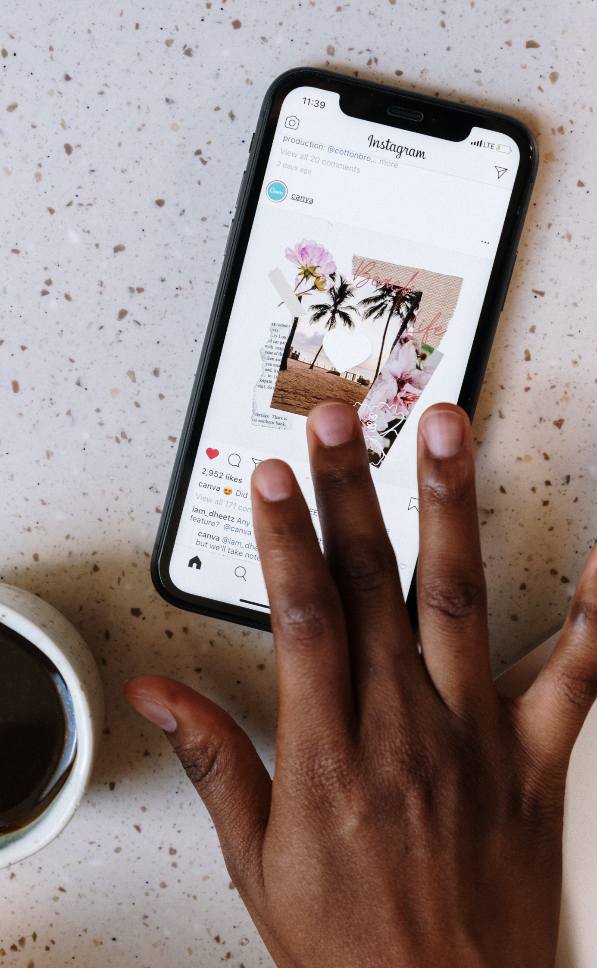
How can we protect ourselves and others?
Things I can control:
    What I post; Who I follow; Who you message; Privacy settings;
    What I comment on; Strong passwords
Things my family and friends can control:
    How much you are using social media; Advice; Parental controls;
    Talk to you about your social media use
Things social media companies/government policies can aim to control:
    Blocking fake accounts; Filtering negative content; Government to work with social media companies; Cyber crime units; Keep data private; Control adverts
Notes:
Ask students to feedback ideas first, then, go through the examples on the board. Some examples of things you can control are [1] what you post to social media, [2] who you follow and who you allow to follow you as well, [3] who you are messaging, [4] privacy settings of your different social media accounts, [5] things you are engaging with, i.e. commenting on, type of comments etc., and [6] strong passwords to protect your social media accounts from hackers.
Some examples of the things your family and friends can control are [1] how much you are using social media – having boundaries in place, [2] being there for support and advice, and being able to openly talk about social media use and what you are doing on those sites, and [3] having parental controls in place.
Now, things social media companies/government policies can aim to control is always a little bit trickier. BUT these could play a huge role in helping you guys stay safe on social media. Some examples of some of the things they could do is [1] blocking fake accounts, [2] filtering negative content, [3] government work with social media companies, [4] have cyber crime units in place to take things seriously, [5] keep all data on social media private, [5] have control over advertisements. ASK STUDENTS: what do you think the chances of these practices being put into place by social media companies/government? And why? Stimulate discussion.

Slide 9
Advice for others
What advice would you give other young people your age, to keep positive and safe on social media?
Think about:
  Your image/ the way you present yourself
  Managing negative interactions
  Keeping safe
  How much you use social media and when you use it
Notes:
Taking into consideration all of the content we have covered today. What advice would you give to other young people your age to keep positive and stay safe on social media? Think about [1] your image/the way you present yourself, [2] managing negative interactions, [3] keeping safe [4] how much you use social media and when you use it. Activity: Write your top three pieces of advice on post-it notes and collate these within your group, which is best? Alternative activity: Now design and produce posters/leaflets showcasing your pieces of advice, and why this advice is important (you may want to include some of the positives and negatives of social media on this too). 20 minutes or till the end of the session

Slide 10

Over the next week try to use your own advice to use social media safely
Notes:
End the session – ask students to try to use their own advice to stay safe on social media

