Slide 1
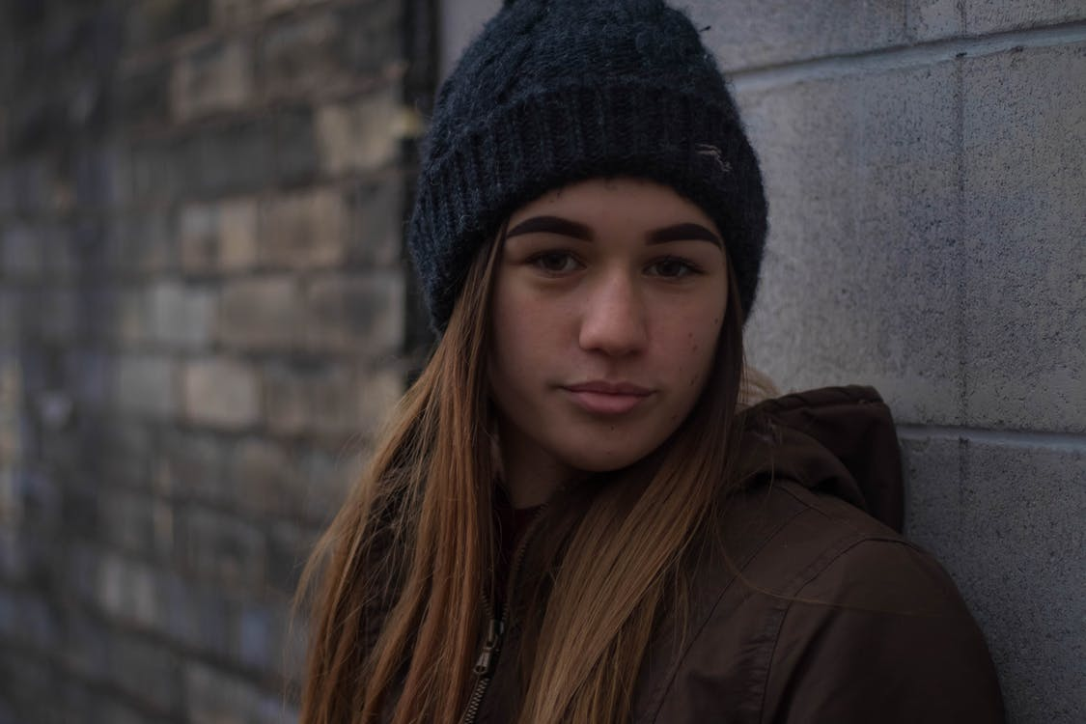


Chelsea
Age 14
POSITIVE EXPERIENCES
Keep in touch/having a laugh with friends
Experimenting with her appearance in selfies
Likes Instagram & Snapchat
NEGATIVE EXPERIENCES
Unwanted messages from people she doesn’t know
Sometimes gets FOMO from following Kylie Jenner
Negative comments about appearance

Slide 2
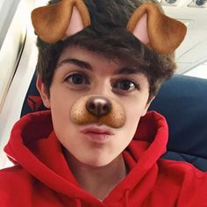

Harry
Age 13
POSITIVE EXPERIENCES
Banter with friends
Trying to recreate viral videos
Likes Snapchat & TikTok
NEGATIVE EXPERIENCES
Sometimes banter goes to far/feels bad
Personal information stolen from opening Snapchat links

Slide 3
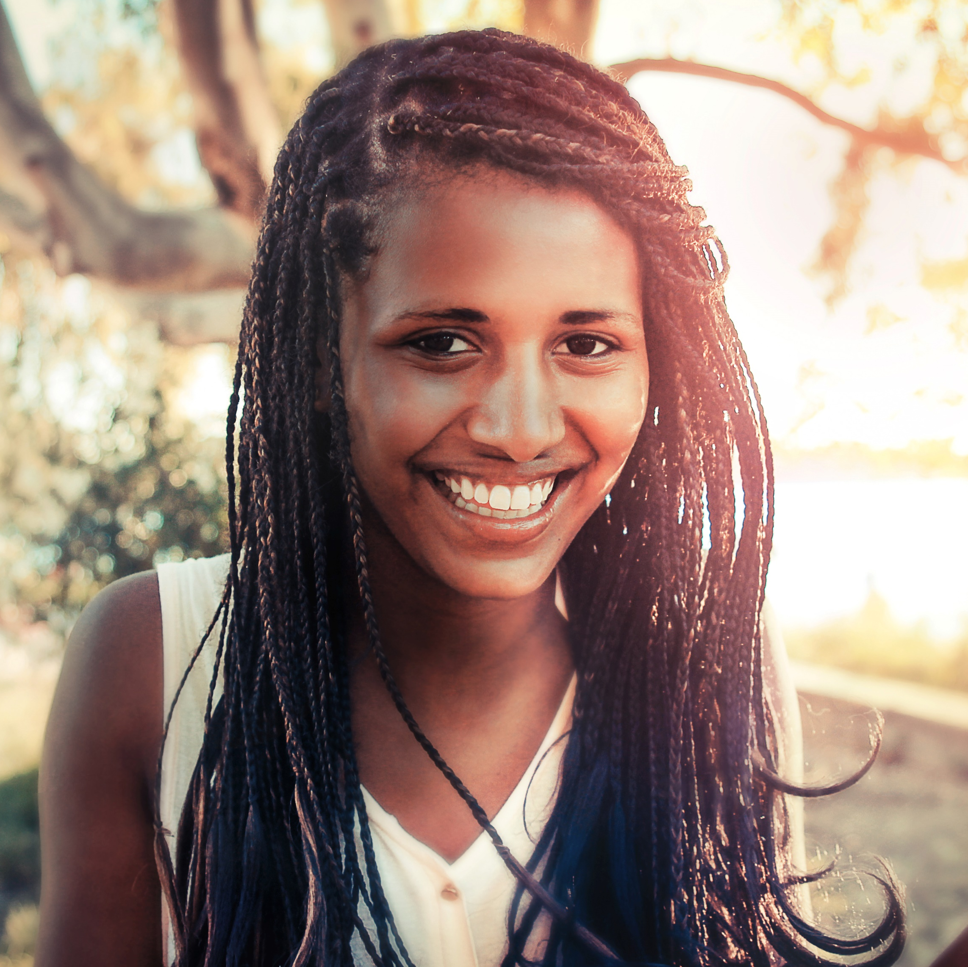
Jasmine
Age 13
POSITIVE EXPERIENCES
Met people online who like the same music as her
Posts videos of herself singing, gets positive feedback
Likes Instagram & TikTok
NEGATIVE EXPERIENCES
Received a message from someone claiming to be in the music industry, turned out to be a scam

Slide 4
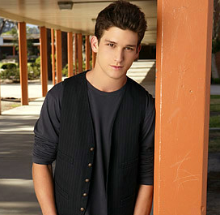

Sam
Age 14
POSITIVE EXPERIENCES
Chat to people about his interests around gaming
Likes Discord & Instagram
NEGATIVE EXPERIENCES
Seen inappropriate content

